Slide 1

Gokaraju Rangaraju Institute of Engineering and Technology
(Autonomous)
Department of Data Science
Mini Project Work
(CSE(DS))
Review 4: Execution Cycle 1 Presentation
Batch No - 18
Presented by:
1. M Isaac Manohar (23241A6741)
2. B. Sai Shiva Reddy (23241A6704)
3. K. Vishnu Vardhan (23241A6733)
Under the Guidance of:
Dr. Aruna Kumari
Assistant Professor
Data Science

Slide 2
A Comparative Study of ML Models for
Tumor Classification

Slide 3
Link to google drive

Slide 4
Introduction:
Tumor classification plays a crucial role in early cancer detection and effective treatment planning.
Increasing medical data and complex tumor characteristics make manual diagnosis challenging and time-consuming.
Traditional diagnostic methods rely heavily on expert interpretation, which may lead to variability and human error.
There is a growing need for automated systems that can analyze tumor features accurately and consistently.
Machine Learning algorithms provide efficient and data-driven approaches for tumor classification.
Multiple ML models such as Logistic Regression, SVM, KNN, Decision Tree, and Random Forest can be compared to identify the most reliable approach.

Slide 5
Literature review:
Logistic Regression for Medical Diagnosis (2023)
• Uses Logistic Regression for binary tumor classification.
• Serves as a baseline linear model.
• Provides interpretable feature coefficients.
• Achieves moderate accuracy on structured datasets.
• Performs well on linearly separable data.
• Limited performance on complex nonlinear patterns.

Slide 6
K-Nearest Neighbors in Tumor Classification (2023)
•Applies distance-based learning for tumor prediction.
• Simple and non-parametric approach.
• Performs well on small and clean datasets.
• Accuracy depends on optimal K selection.
• Sensitive to feature scaling.
• Slower prediction for larger datasets.

Slide 7
Support Vector Machine for Cancer Detection (2023)
• Uses SVM for high-dimensional tumor data.
• Effective in handling complex decision boundaries.
• Achieves high accuracy with proper kernel selection.
• Requires careful hyperparameter tuning.
• Computational cost increases with dataset size.

Slide 8
Machine Learning Approaches for Brain Tumor Classification (2023)
• Compares classical ML models on MRI features.
• Uses texture and shape-based feature extraction.
• SVM showed stable and consistent results.
• Emphasizes importance of preprocessing.
• Limited dataset size affects generalization.

Slide 9
Random Forest-Based Tumor Prediction Model (2024)
• Implements ensemble learning for tumor classification.
• Reduces overfitting compared to Decision Tree.
• Achieves high precision and recall.
• Handles high-dimensional features effectively.
• Less interpretable than simple models.

Slide 10
Deep Learning-Based Brain Tumor Classification (2024)
• Uses Convolutional Neural Networks (CNN).
• Automatically extracts features from MRI images.
• Achieves higher accuracy than traditional ML models.
• Requires large annotated image datasets.
• High computational and GPU requirements.

Slide 11
Comparative Study of ML Algos for Breast Cancer Diagnosis (2024)
• Compares Logistic Regression, SVM, KNN, and Random Forest.
• Uses multiple evaluation metrics.
• Random Forest achieved best overall performance.
• Demonstrates importance of model comparison.
• Limited hyperparameter optimization

Slide 12
Comparative Analysis of ML and DL Models in Oncology (2024)
• Evaluates both classical ML and deep learning approaches.
• Uses Accuracy, Precision, Recall, and F1-score.
• Deep learning performs better with large datasets.
• Classical ML effective for structured data.
• Does not standardize preprocessing across models.

Slide 13
Hybrid ML and Deep Learning Models for Tumor Detection (2025)
• Combines ML classifiers with deep learning features.
• Improves overall classification accuracy.
• Uses feature fusion techniques.
• Enhances generalization capability.
• Increases model complexity.

Slide 14
Explainable AI in Medical Tumour Classification (2025)
• Integrates explainable AI with tumor classification models.
• Provides interpretation of model predictions.
• Improves trust in AI-based medical systems.
• Maintains competitive classification performance.
• Adds computational and implementation complexity.

Slide 15
Literature Review Summery
Source | Research Objective or Research Question | Methodology | Key Findings | Relevance to Project | Techniques | Accuracy & Performance Measures | Advantages | Disadvantages
IEEE Access (2023) | Classify breast tumors using classical ML models | Supervised ML classification | SVM and RF achieved high accuracy | Supports ML-based tumor prediction | SVM, Random Forest | ~95% Accuracy | Stable performance | Limited dataset size
IEEE Conf. (2023) | Compare ML models for cancer detection | Comparative experimental study | RF outperformed DT and KNN | Motivates model comparison | RF, DT, KNN | F1-score ~94% | Identifies best model | Basic hyperparameter tuning
Springer (2023) | Use SVM for tumor classification | Margin-based classification | High precision for malignant class | Basis for SVM implementation | SVM (RBF Kernel) | ~96% Accuracy | Handles high-dimensional data | Requires parameter tuning

Slide 16
Source | Research Objective or Research Question | Methodology | Key Findings | Relevance to Project | Techniques | Accuracy & Performance Measures | Advantages | Disadvantages
Elsevier (2024) | Apply Random Forest for tumor prediction | Ensemble learning | Reduced overfitting compared to DT | Supports ensemble approach | Random Forest | Recall > 95% | Robust and stable | Less interpretable
IEEE Access (2024) | Evaluate KNN in tumor diagnosis | Distance-based learning | Performs well on small datasets | Baseline comparison model | KNN | ~93% Accuracy | Simple implementation | Slow on large datasets
MDPI (2024) | Deep learning for brain tumor classification | CNN-based image classification | CNN outperformed classical ML | Shows DL advancement | CNN | ~98% Accuracy | Automatic feature extraction | High computational cost

Slide 17
Source | Research Objective or Research Question | Methodology | Key Findings | Relevance to Project | Techniques | Accuracy & Performance Measures | Advantages | Disadvantages
Springer (2024) | Feature selection in medical diagnosis | Analytical ML study | Feature reduction improved accuracy | Highlights preprocessing importance | PCA, Feature Selection + ML | Improved F1-score | Reduces complexity | May remove useful features
IEEE Access (2025) | Hybrid ML model for tumor detection | Combined ML & DL framework | Improved overall classification | Encourages model enhancement | CNN + RF | ~97% Accuracy | Better generalization | Complex architecture
Frontiers (2025) | Explainable AI in tumor classification | ML + Explainability methods | Improved interpretability | Adds trust to medical AI | SHAP, LIME + ML | High interpretability score | Transparent decisions | Extra computation

Slide 18
Source | Research Objective or Research Question | Methodology | Key Findings | Relevance to Project | Techniques | Accuracy & Performance Measures | Advantages | Disadvantages
Elsevier (2025) | Comparative analysis of ML vs DL in oncology | Systematic evaluation | DL better for images, ML strong for tabular data | Justifies structured ML comparison | SVM, RF, CNN | Accuracy, Precision, Recall | Balanced evaluation | No standardized preprocessing

Slide 19
Research Gaps
• Existing tumor classification studies often focus on one or two ML algorithms without performing a broad comparative analysis.
• Many studies evaluate models primarily using accuracy, without considering important metrics such as Precision, Recall, and F1-Score.
• Deep learning approaches require large annotated datasets and high computational resources, limiting practical implementation in smaller healthcare settings.
• Several research works rely heavily on manual model selection and hyperparameter tuning, which requires domain expertise.

Slide 20
Research Gaps
• Limited emphasis is placed on balancing model accuracy, interpretability, and computational efficiency in medical diagnosis.
• Many studies test models on specific datasets without validating generalization under standardized preprocessing conditions.
• Few works provide a systematic comparison of multiple ML models under identical experimental settings.
• There is a need for a structured and fair comparative framework to identify the most reliable algorithm for tumor classification.

Slide 21
Problem statement
Early and accurate tumor classification is essential for effective cancer treatment and improved patient survival. Traditional diagnostic methods rely on manual interpretation of medical data, which can be time-consuming and prone to human error. With the increasing volume of medical datasets, consistent and efficient analysis of tumor features has become challenging. Although Machine Learning techniques are widely used for tumor detection, many studies focus on limited models and lack systematic comparison under standardized conditions. Therefore, there is a need for an automated and structured framework that evaluates multiple ML algorithms and identifies the most reliable model for tumor classification to support medical decision-making.

Slide 22
Objectives
• To implement and compare multiple Machine Learning algorithms, including Logistic Regression, Support Vector Machine (SVM), K-Nearest Neighbors (KNN), Decision Tree, and Random Forest for tumor classification.
• To preprocess and standardize tumor dataset features using normalization techniques to ensure fair and consistent model evaluation.
• To evaluate model performance using multiple metrics such as Accuracy, Precision, Recall, and F1-Score for comprehensive assessment.
• To analyze model behavior in terms of computational efficiency, stability, and overfitting under identical experimental conditions.
• To identify the most reliable and efficient ML algorithm for distinguishing between benign and malignant tumors.

Slide 23
Proposed Solution
Data Preparation Layer
• Collects tumor dataset (Breast Cancer Wisconsin Dataset).
• Handles missing values and performs data cleaning.
• Applies feature normalization using StandardScaler.
• Performs stratified train-test split for fair evaluation.
Model Training Layer
• Implements multiple supervised ML algorithms:
Logistic Regression, SVM, KNN, Decision Tree, and Random Forest.
• Trains all models under identical preprocessing conditions.
• Applies 5-fold cross-validation to ensure reliability and reduce bias.

Slide 24
Proposed Solution (Contd..)
Model Optimization Module
• Performs basic hyperparameter tuning using GridSearchCV.
• Optimizes SVM kernel and regularization parameters.
• Tunes Random Forest estimators for improved stability.
• Compares tuned vs untuned model performance.
Performance Evaluation Layer
• Evaluates models using Accuracy, Precision, Recall, and F1-Score.
• Generates Confusion Matrix to analyze False Positives and False Negatives.
• Plots ROC Curve and computes AUC score for medical relevance.
• Identifies the best-performing model based on balanced metrics.

Slide 25
Proposed Solution (Contd..)
Interpretability Module
• Extracts feature importance from Random Forest model.
• Analyzes Logistic Regression coefficients for feature impact.
• Identifies top tumor attributes influencing classification.
• Enhances transparency for medical decision support.
Model Selection & Deployment Layer
• Selects the most reliable model based on performance and stability.
• Ensures minimized false negatives for malignant cases.
• Prepares the selected model for real-time tumor prediction.
• Supports data-driven clinical decision-making.

Slide 26
Novelty
Single Model Evaluation vs Systematic Comparative Evaluation
• Existing studies often evaluate only one or two ML algorithms for tumor classification.
• Our project performs a structured comparison of five supervised ML models under identical preprocessing and evaluation conditions.
Accuracy-Only Evaluation vs Multi-Metric Assessment
• Many prior works focus primarily on overall accuracy.
• Our study evaluates models using Accuracy, Precision, Recall, F1-Score, and ROC-AUC to ensure balanced medical assessment.
Simple Train-Test Split vs Cross-Validation-Based Reliability
• Several implementations rely on a single train-test split, which may introduce bias.
• Our framework applies 5-fold cross-validation to ensure stability and reliability of performance results.

Slide 27
Novelty
Black-Box Prediction vs Interpretable Tumor Classification
• Traditional ML implementations often report predictions without interpretability analysis.
• Our approach includes feature importance extraction and coefficient analysis to identify key tumor attributes influencing classification.
Generic Performance Analysis vs Medical-Relevant Error Analysis
• Existing works rarely emphasize clinical impact of misclassification.
• Our system analyzes confusion matrices with focus on minimizing false negatives in malignant tumor detection.
Unoptimized Models vs Tuned and Standardized Framework
• Many studies use default hyperparameters without systematic tuning.
• Our framework incorporates basic hyperparameter optimization and standardized preprocessing for fair comparison.

Slide 28
Architecture Diagram
User Input
Breast Cancer Dataset
Brain MRI Dataset
Data Preprocessing
Logistic Regression
Support Vector Machine (SVM)
K-Nearest Neighbours(KNN)
Decision Tree
Random Forest
Performance Evaluation using Accuracy, Precision, Recall, F1-score
Tumor Detection Based on Model with best Accuracy

Slide 29
Methodology / Algorithms
Algorithms Used:
Logistic Regression: Linear classification model used as a baseline for binary tumor prediction (Benign vs Malignant).
Support Vector Machine (SVM): Margin-based classifier that identifies optimal decision boundaries in high-dimensional feature space.
K-Nearest Neighbors (KNN): Distance-based classification algorithm that assigns class labels based on nearest feature similarity.
Decision Tree: Rule-based model that creates hierarchical decision paths using tumor feature thresholds.
Random Forest: Ensemble learning method that combines multiple decision trees to improve accuracy and reduce overfitting.

Slide 30
Methodology/Algorithms
Cross-Validation (5-Fold): Ensures model reliability by validating performance across multiple data splits.
ROC-AUC Analysis: Measures classification performance using Receiver Operating Characteristic curves and Area Under Curve metric.
Feature Importance Analysis: Identifies key tumor attributes contributing to classification decisions.

Slide 31
Methodology
1. Dataset Collection
• Uses Breast Cancer Wisconsin (Diagnostic) Dataset.
• Target variable: Benign or Malignant classification.
2. Data Preprocessing
• Handles missing values and removes irrelevant attributes.
• Applies feature normalization using StandardScaler.
• Performs stratified train-test split (80–20).
3. Model Training
• Implements five supervised ML algorithms
• Trains all models under identical preprocessing conditions.
• Applies 5-fold cross-validation for reliability

Slide 32
4. Performance Evaluation
• Evaluates models using Accuracy, Precision, Recall, and F1-Score.
• Generates Confusion Matrix for detailed error analysis.
• Plots ROC Curve and computes AUC score for medical relevance
5. False Negative Analysis
• Focuses on minimizing malignant cases misclassified as benign.
• Interprets clinical impact of classification errors.
6. Interpretability & Feature Analysis
• Extracts feature importance from Random Forest model.
• Analyzes Logistic Regression coefficients.
7. Final Model Selection
• Selects the most reliable model based on balanced metrics.
• Ensures stability, interpretability, and clinical relevance.

Slide 33
Software and Hardware Requirements
SOFTWARE | HARDWARE
• Operating System: Windows / Linux / macOS • Programming Language: Python • Machine Learning Library: Scikit-learn • Data Processing: Pandas, NumPy • Data Visualization: Matplotlib, Seaborn • Model Evaluation: Scikit-learn Metrics (ROC, Confusion Matrix) • Development Tool: VS Code / Jupyter Notebook | • System: Laptop / PC for model training and testing • Processor: Intel i5 / Ryzen 5 or above • RAM: Minimum 8 GB (16 GB recommended) • Storage: 10 GB free space • Internet Connection: Required for library installation

Slide 34
Datasets Details
Dataset Source
• Breast Cancer Wisconsin (Diagnostic) Dataset
• Available from UCI Machine Learning Repository
• Also accessible via Scikit-learn built-in datasets
UCI Repository Link:
https://archive.ics.uci.edu/ml/datasets/Breast+Cancer+Wisconsin+(Diagnostic)
Dataset Size
• 569 tumor samples
• 30 numerical features per sample
• 357 Benign cases
• 212 Malignant cases
Dataset Features
• Radius, Texture, Perimeter, Area
• Smoothness, Compactness, Concavity
• Symmetry, Fractal Dimension
• Mean, Standard Error, and Worst values for each feature

Slide 35
Dataset Details (Contd..)
Type of Data
• Structured numerical tumor feature data
• Diagnostic measurements computed from digitized biopsy images
• Pre-extracted statistical features (Mean, Standard Error, Worst values)
Features / Attributes
• 30 numerical features per tumor sample
• Radius, Texture, Perimeter, Area
• Smoothness, Compactness, Concavity
• Symmetry, Fractal Dimension
• Statistical variations of each feature (mean, SE, worst)

Slide 36
Dataset Details (Contd..)
Class Labels
• Benign (0)
• Malignant (1)
Binary classification problem.
Purpose of Dataset Usage
• Train and evaluate supervised ML classification models
• Compare performance of multiple algorithms under identical conditions
• Analyze model reliability using cross-validation
• Evaluate classification using Accuracy, Precision, Recall, F1-score, and ROC-AUC
• Identify most influential tumor features through feature importance analysis
• Support data-driven decision-making in tumor diagnosis

Slide 37
Module connectivity diagram
Input Module
Breast Cancer Dataset
Brain Cancer Dataset
Data Preprocessing Module
(Cleaning, Scaling, test-train split)
Model Training Module
CNN, LR, SVM, KNN DT, Random Forest on pre-processed dataset
Validation and Optimization Module
(Cross-validation + GridSearchCV + Hyperparameter Tuning)
Performance Evaluation Module
(Accuracy, Precision, Recall, ROC, AUC)
Interpretability Module
(Explains Decision Making)
Model Selection and Final Output Module
(Best Model + Prediction System)

Slide 38
Modules description
Input Module
Role:
The Input Module is responsible for loading the tumor dataset used for classification.
What It Does:
• Loads the Breast Cancer Wisconsin dataset
• Verifies dataset structure and target labels
• Checks for missing or inconsistent values
Why It Is Important:
• Ensures reliable and clean data before model training
• Prevents errors caused by incomplete or corrupted input
Output:
Validated dataset ready for preprocessing.

Slide 39
Data Preprocessing Module
Role:
Prepares raw tumor feature data for machine learning training.
What It Does:
• Handles missing values (if any)
• Normalizes features using StandardScaler
• Performs stratified train-test split
• Separates feature matrix (X) and target labels (y)
Why It Is Important:
• Ensures fair comparison across models
• Prevents bias due to scale differences
• Maintains class balance during training
Output:
Processed training and testing datasets.

Slide 40
Model Training Module
Role:
Implements multiple supervised ML algorithms for tumor classification.
What It Does:
• Trains Logistic Regression
• Trains Support Vector Machine (SVM)
• Trains K-Nearest Neighbors (KNN)
• Trains Decision Tree
• Trains Random Forest
Why It Is Important:
• Enables systematic comparison of different algorithms
• Identifies model strengths and weaknesses
Output:
Trained machine learning models.

Slide 41
Validation & Optimization Module
Role:
Improves model reliability and performance.
What It Does:
• Applies 5-fold cross-validation
• Performs hyperparameter tuning using GridSearchCV
• Compares tuned and default model performance
Why It Is Important:
• Reduces overfitting
• Ensures scientifically reliable evaluation
Output:
Optimized and validated models.

Slide 42
Performance Evaluation Module
Role:
Evaluates model performance using multiple metrics.
What It Does:
• Calculates Accuracy, Precision, Recall, and F1-Score
• Generates Confusion Matrix
• Plots ROC curve and computes AUC score
Why It Is Important:
• Provides comprehensive performance analysis
• Identifies false negatives in malignant detection
• Ensures medical relevance of results
Output:
Comparative performance results of all models.

Slide 43
Interpretability Module
Role:
Explains model decision-making process.
What It Does:
• Extracts feature importance from Random Forest
• Analyzes Logistic Regression coefficients
• Identifies most influential tumor attributes
Why It Is Important:
• Enhances transparency
• Supports medical decision-making
• Builds trust in AI predictions
Output:
Feature importance insights and explanation reports.

Slide 44
Model Selection & Final Output Module
Role:
Selects the best-performing model for tumor prediction.
What It Does:
• Compares models based on balanced metrics
• Selects model with high recall and stability
• Prepares final prediction system
Why It Is Important:
• Ensures reliable tumor classification
• Minimizes risk of misdiagnosis
Output:
Final selected tumor classification model.

Slide 45
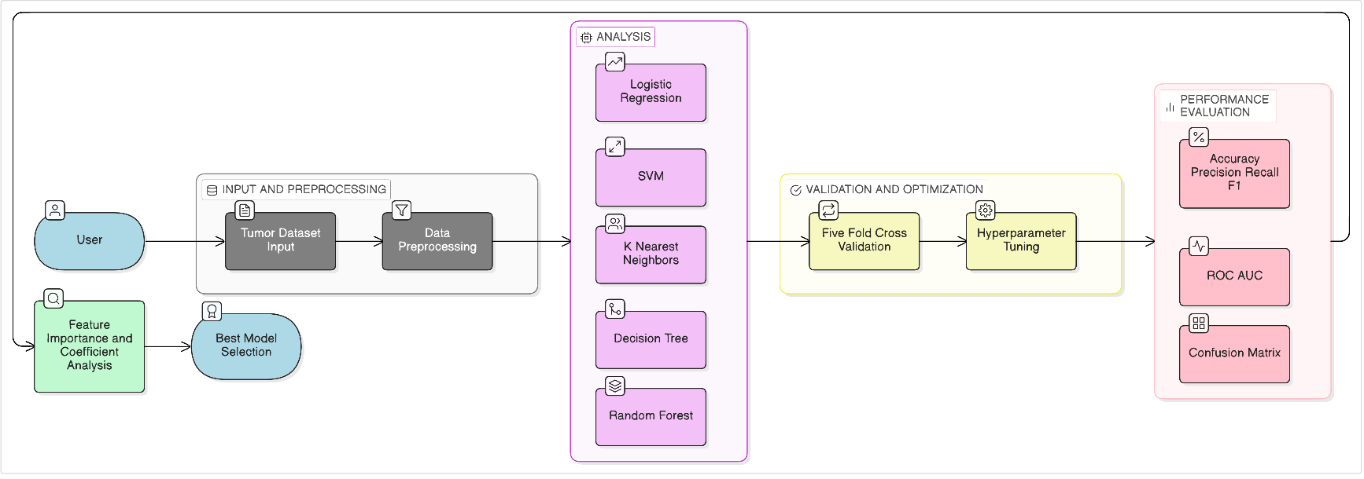
Data flow diagram

Slide 46
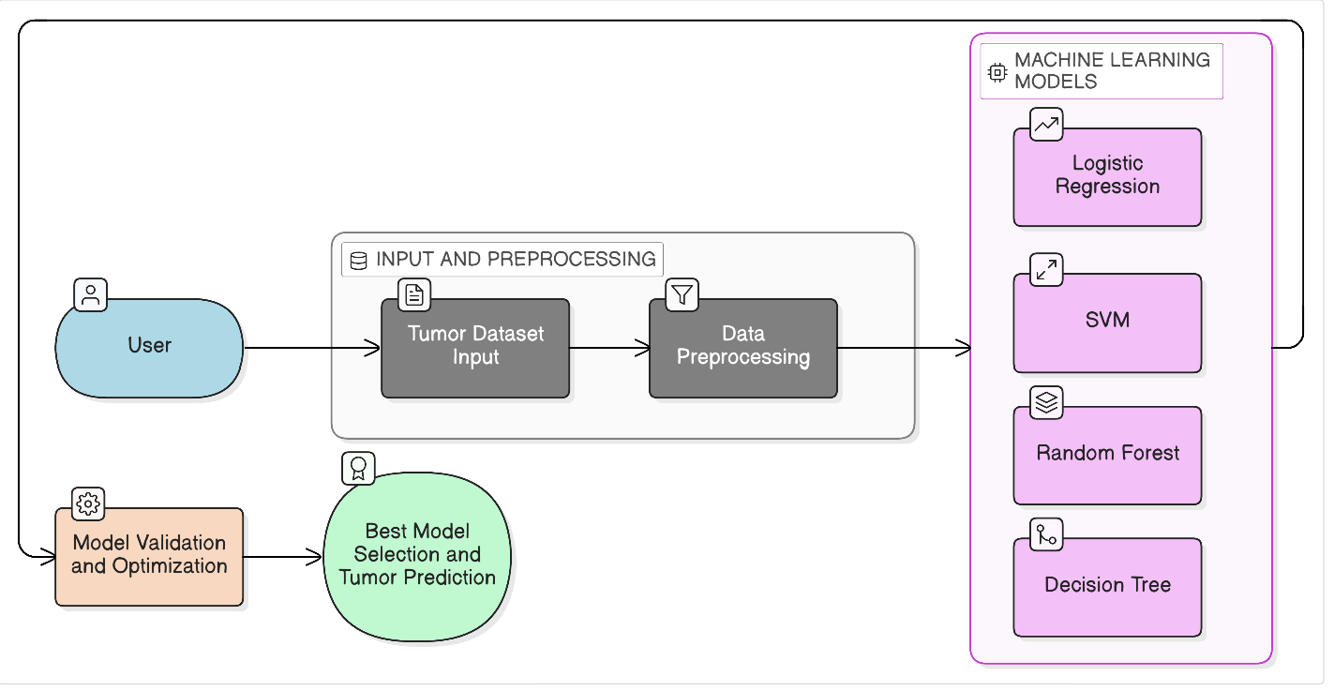
Control flow diagram

Slide 47
Implementation Details
1. Logistic Regression
A linear classification model used as a baseline
Works by calculating probability using a sigmoid function
Classifies tumor as:
  0 → Benign
  1 → Malignant
Assumes a linear relationship between features and output
In your project:
Used as a reference model
Helps compare performance with advanced models
2. Support Vector Machine (SVM)
Finds an optimal boundary (hyperplane) that separates classes
Maximizes the margin between data points
Uses kernel functions (linear, RBF) for complex data
In your project:
Used for handling high-dimensional tumor features
Hyperparameters tuned:
  C (regularization)
  Kernel type

Slide 48
3. K-Nearest Neighbors (KNN)
A distance-based algorithm
Classifies based on the majority class of nearest neighbors
Uses distance metrics like Euclidean distance
In your project:
Tested for simple pattern recognition
Performance depends on:
  Number of neighbors (K)
  Feature scaling
4. Decision Tree
Builds a tree-like structure using feature-based rules
Splits data based on feature thresholds
Easy to interpret
In your project:
Used for understanding decision-making logic
May overfit without control

Slide 49
5. Random Forest
An ensemble of multiple decision trees
Uses bagging (random sampling)
Final prediction = majority vote of trees
In your project:
Reduces overfitting compared to single tree
Provides feature importance analysis
Hyperparameters tuned:
  Number of trees
  Tree depth

Slide 50
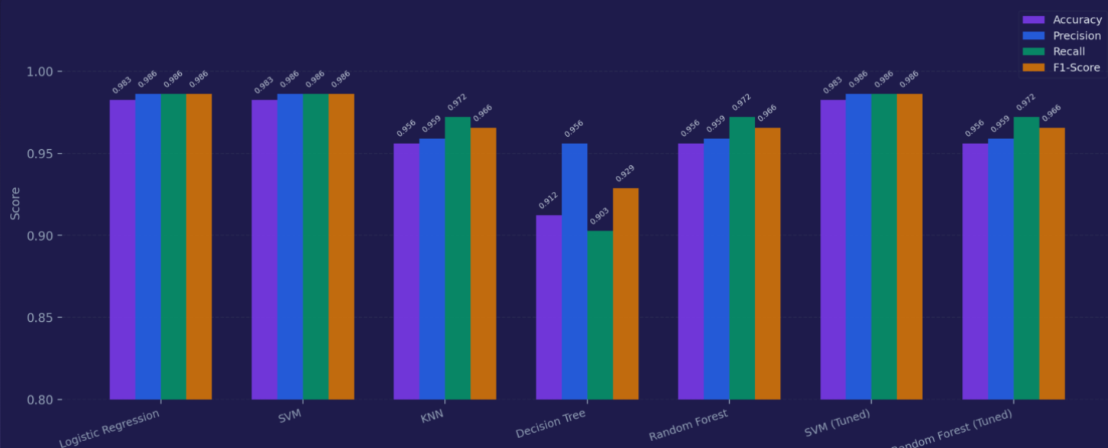
Experimental Results
1.Model Performance Comparison
Key Observations
Logistic Regression and SVM achieved the highest accuracy (98.25%)
Both models show balanced Precision, Recall, and F1-score (~98.61%)
KNN and Random Forest achieved moderate performance (~96%)
Decision Tree showed the lowest accuracy (91.23%)
Hyperparameter tuning resulted in minimal improvement

Slide 51
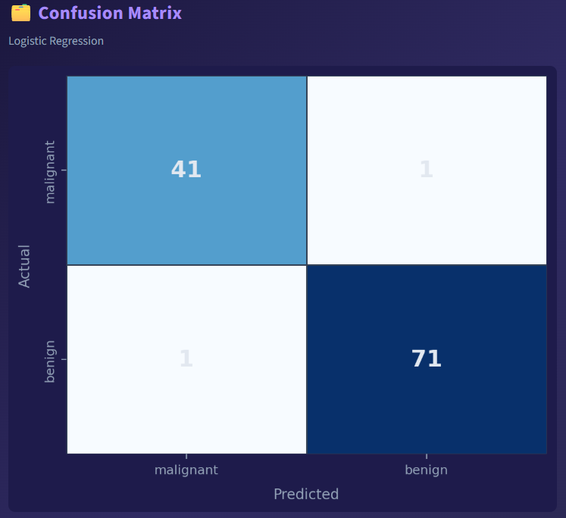
Insights
The dataset is well-structured and linearly separable
Simple models like Logistic Regression and SVM perform exceptionally well
Complex models (Random Forest) did not outperform simpler models
Decision Tree likely suffered from overfitting
2.Confusion Matrix Analysis
Confusion matrix of BEST model
True Positives: correctly detected malignant
False Negatives: critical errors
Model minimizes false negatives

Slide 52
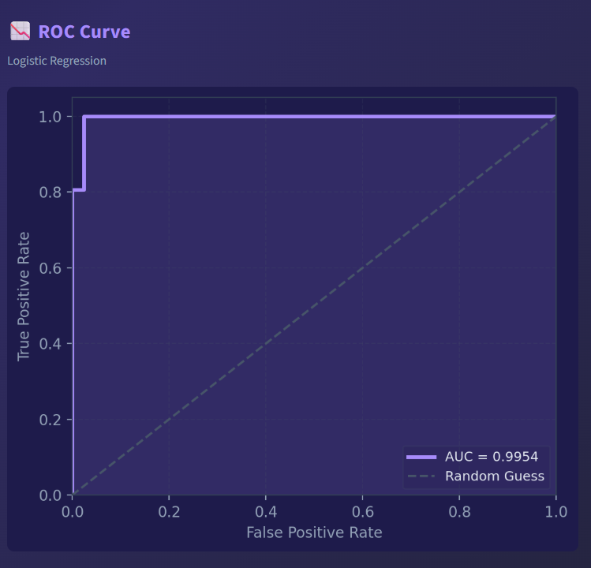
3.ROC Curve Analysis
What to include:
ROC curve graph (best model)
What to write:
AUC close to 1 indicates strong performance
Model shows good separation between classes
What to say:
“The model demonstrates strong classification capability with high AUC score.”
4.Error Analysis & Failure Cases
What to include:
Why errors happen
What to write:
Some tumors have similar feature values
Overlapping data causes misclassification
Small dataset limits generalization
What to say:
“Errors occur mainly due to feature similarity and limited dataset size.”

Slide 53
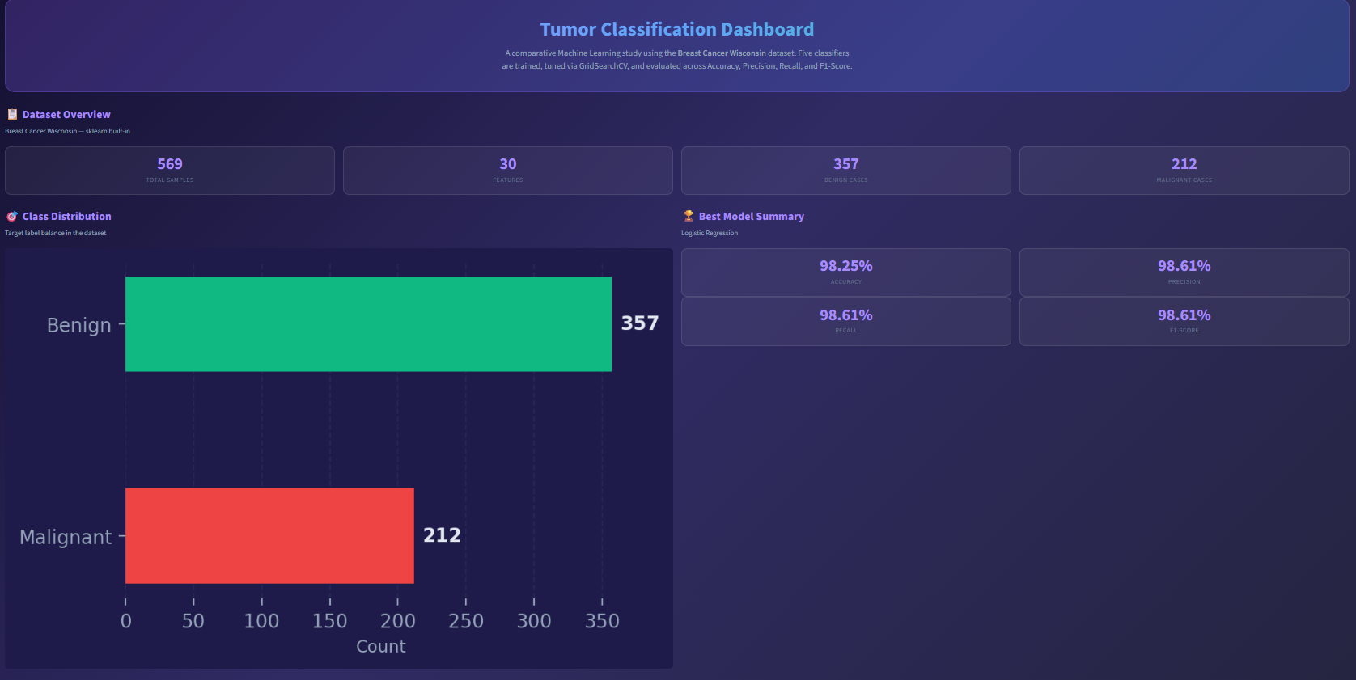
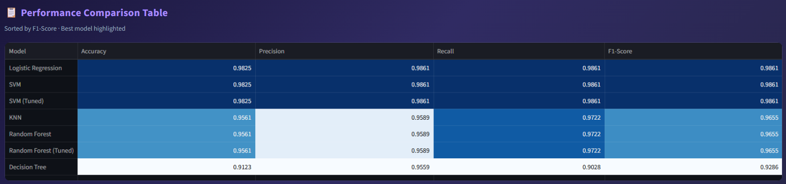
Screenshots of Results

Slide 54
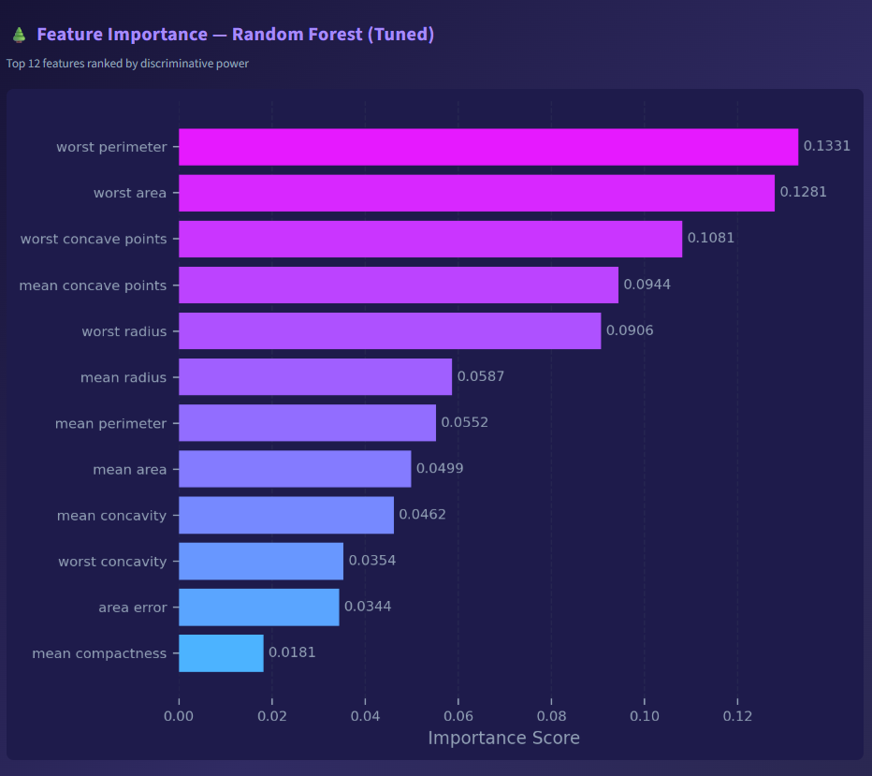
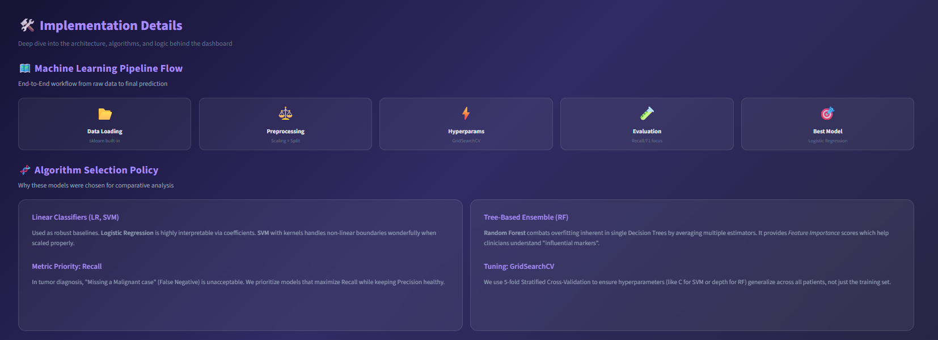

Slide 55
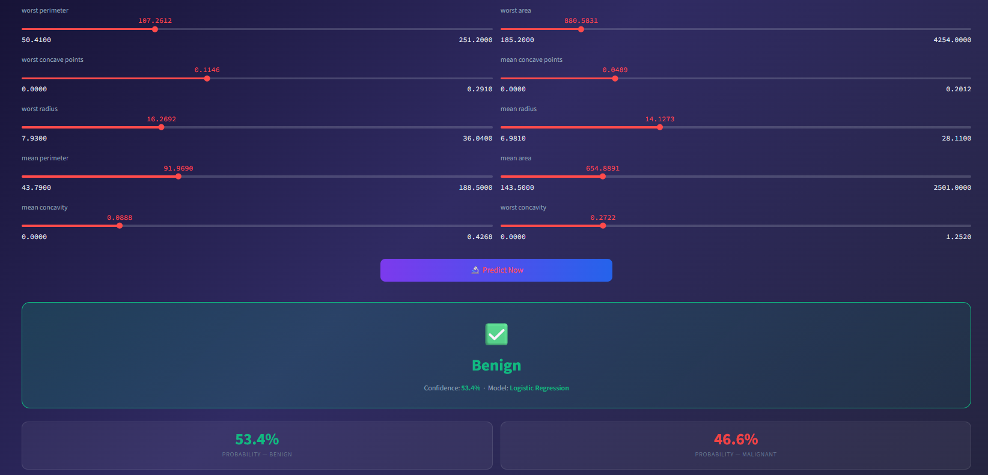

Slide 56
Conclusion
This project presented an effective approach to tumor classification by integrating a Model Optimization Module with a structured Performance Evaluation Layer. Hyperparameter tuning using GridSearchCV was applied to improve model performance, particularly optimizing SVM kernels and regularization parameters, as well as tuning Random Forest estimators for better stability. The comparison between tuned and untuned models clearly showed that optimization plays a key role in enhancing prediction accuracy.
The performance of the models was thoroughly evaluated using key metrics such as Accuracy, Precision, Recall, and F1-Score. In addition, tools like the Confusion Matrix helped analyze False Positives and False Negatives, which are critical in medical diagnosis. The ROC Curve and AUC score further provided insights into the model’s ability to distinguish between classes, ensuring medical relevance and reliability.
Overall, the project demonstrates that combining proper model tuning with comprehensive evaluation techniques leads to more accurate and dependable tumor classification systems. This approach helps in identifying the best-performing model based on balanced metrics, making it suitable for real-world healthcare applications and future improvements.

Slide 57
Future Enhancements
This project can be further enhanced by incorporating larger and more diverse medical datasets to improve model generalization and accuracy. The integration of advanced deep learning techniques such as Convolutional Neural Networks (CNNs) can significantly enhance feature extraction, especially for image-based tumor classification tasks. Future work can also focus on deploying the system as a real-time web or mobile application, making it more accessible and practical for clinical use.
Additionally, incorporating explainable AI methods will help medical professionals understand and trust the model’s predictions. Further improvements can include combining multiple models through ensemble techniques, integrating cloud-based processing for scalability, and continuously updating the system with new medical data to maintain high performance and reliability in real-world healthcare environments.

Slide 58
Abstract
This project presents a comparative study of machine learning models for tumor classification, aiming to improve the accuracy and reliability of medical diagnosis. The study involves preprocessing medical datasets, extracting relevant features, and applying various machine learning algorithms such as Support Vector Machine (SVM) and Random Forest. A key focus of the project is the Model Optimization Module, where hyperparameter tuning is performed using GridSearchCV to enhance model performance by optimizing parameters like SVM kernels and Random Forest estimators. The performance of both tuned and untuned models is analyzed to understand the impact of optimization. Additionally, a comprehensive Performance Evaluation Layer is implemented using metrics such as Accuracy, Precision, Recall, and F1-Score to assess model effectiveness. Tools like Confusion Matrix are used to examine False Positives and False Negatives, while ROC curves and AUC scores provide insights into the model’s classification capability in medical contexts. The results indicate that optimized models outperform baseline models in terms of stability and predictive accuracy. Overall, this project highlights the importance of proper model selection, tuning, and evaluation in developing efficient tumor classification systems, contributing to improved decision-making in healthcare applications.

Slide 59
References
W. H. Wolberg, W. N. Street, and O. L. Mangasarian (1995)
Breast Cancer Diagnosis and Prognosis via Linear Programming
IEEE Transactions on Biomedical Engineering, Vol. 42, No. 10.
Street, W. N., Wolberg, W. H., and Mangasarian, O. L. (1993)
Nuclear feature extraction for breast tumor diagnosis
IS&T/SPIE Symposium on Electronic Imaging.
UCI Machine Learning Repository – Breast Cancer Wisconsin (Diagnostic) Dataset
https://archive.ics.uci.edu/ml/datasets/breast+cancer+wisconsin+(diagnostic)
World Health Organization (WHO) – Cancer Fact Sheets and Global Statistics
https://www.who.int/news-room/fact-sheets/detail/cancer
United Nations SDGs – Quality Education & Reduced Inequalities
https://sdgs.un.org/goals/goal3
https://sdgs.un.org/goals/goal9 (official SDG page)

Slide 60
Thank you

